Slide 1




TECHNICAL PRESENTATION
CSA0509-DATABASE MANAGEMENT SYSTEM
BY,
SANDRA SUDEVAN (192424422)

Slide 2
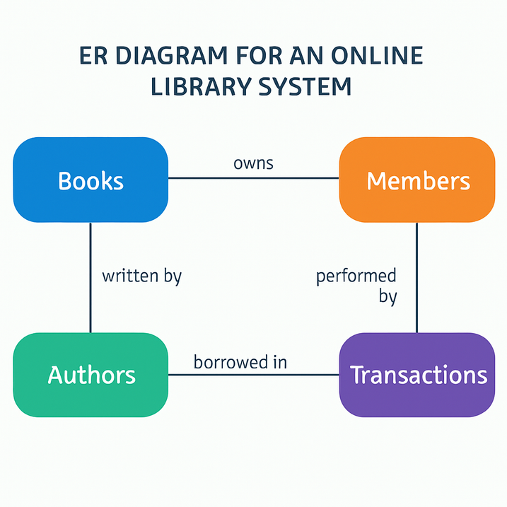
INTRODUCTION
ER Diagram for an Online Library System
ER Diagram represents entities, attributes, and relationships.
Used to design a database before implementation.
Helps organize library data efficiently.
2

Slide 3
Problem Statement & Components
Problem Statement
Manual library management is difficult.
Tracking books and members takes time.
Need an efficient database system.
Components
Entities: Book, Member, Librarian, Author, Issue
Attributes: Book_ID, Title, Member_ID, Issue_Date
Relationships: Member borrows Book, Librarian manages Issue
3

Slide 4
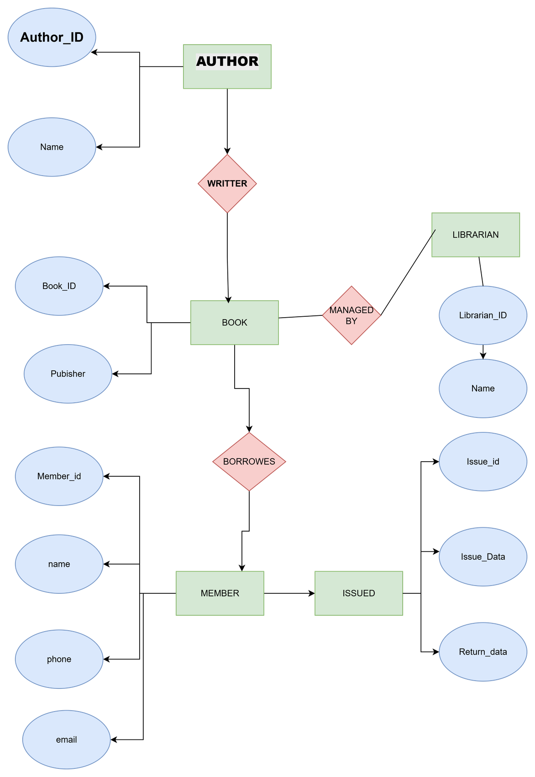
ER Diagram
Rectangles (Entities)
Diamonds (Relationships)
Ovals (Attributes)
7

Slide 5
Advantages & Conclusion
Advantages
Reduces data redundancy
Improves data consistency
Easy database maintenance
Faster information retrieval
Conclusion
ER diagrams provide a clear blueprint for developing an Online Library Management System.

Slide 6
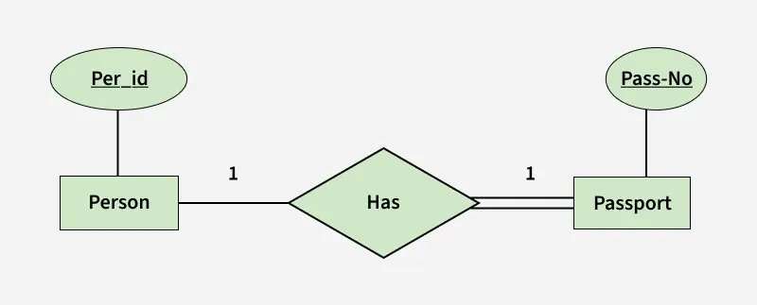
EER Model – University Case Study
Enhanced Entity-Relationship (EER) Model
EER is an advanced version of the ER model.
It represents complex database structures using inheritance.
It introduces generalization and specialization.
Used in systems like universities, hospitals, and banks.
2

Slide 7
Generalization and Specialization
Generalization
Combines similar entities into one superclass.
Example: Student, Faculty, Staff → Person.
Common attributes: Person_ID, Name, Address.
Specialization
Divides a superclass into subclasses.
Example: Faculty → Professor, Assistant Professor, HOD.
Each subclass has its own specific attributes.
3

Slide 8
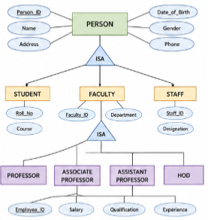
University EER Diagram
University Case Study
Superclass: Person
Subclasses: Student, Faculty, Staff
Faculty Specialization: Professor, Assistant Professor, HOD
Benefits
Reduces data redundancy.
Supports inheritance.
Organizes data efficiently
7

Slide 9
Applications and Conclusion
Applications
University Management System
Hospital Management
Banking System
Human Resource Management
Conclusion
EER improves the ER model by supporting generalization and specialization.
It provides a flexible and efficient database design for complex applications.
3

Slide 10

Data Independence in DBMS
Data independence is the ability to modify the database schema without affecting application programs.
It provides flexibility and simplifies database maintenance.
It is achieved using the three-schema architecture in DBMS.
2

Slide 11
Types of Data Independence
1. Logical Data Independence
Changes can be made to the conceptual schema without affecting user applications.
Example: Adding a new column to a table.
2. Physical Data Independence
Changes to the internal storage do not affect the conceptual schema.
Example: Changing the storage device or file organization.
3

Slide 12
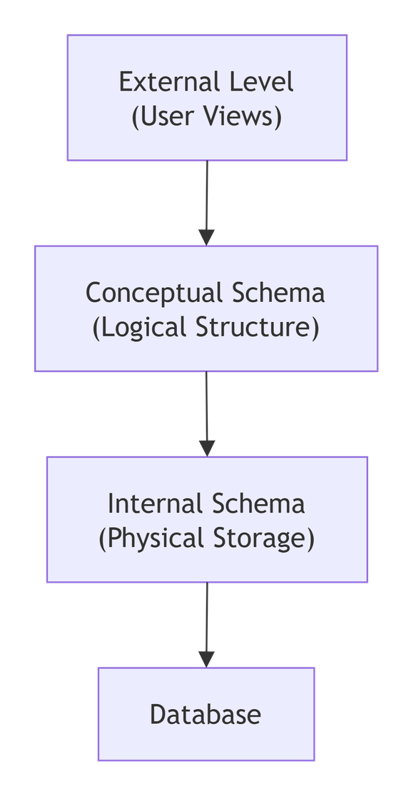
Three-Schema Architecture
DBMS Architecture
External Level – User views of the database.
Conceptual Level – Overall logical structure of the database.
Internal Level – Physical storage of data.
Advantages
Data security
Easy maintenance
Better flexibility
7

Slide 13
Significance and Conclusion
Significance
Reduces the impact of database changes.
Improves scalability and flexibility.
Simplifies application development.
Enhances data management efficiency.
Conclusion
Data independence is an important feature of DBMS that allows changes to the database structure without affecting applications, making systems more reliable and easier to maintain.
3

Slide 14

Software Components of DBMS
A Database Management System (DBMS) consists of software components that manage data efficiently.
These components process queries, store data, and ensure secure transactions.
The three main components are Query Processor, Storage Manager, and Transaction Manager.
2

Slide 15
Main Components
1. Query Processor
Interprets and executes SQL queries.
Optimizes queries for better performance.
2. Storage Manager
Manages data storage on disk.
Controls files, indexes, and memory buffers.
3. Transaction Manager
Ensures data consistency and reliability.
Supports ACID properties and recovery.
3

Slide 16
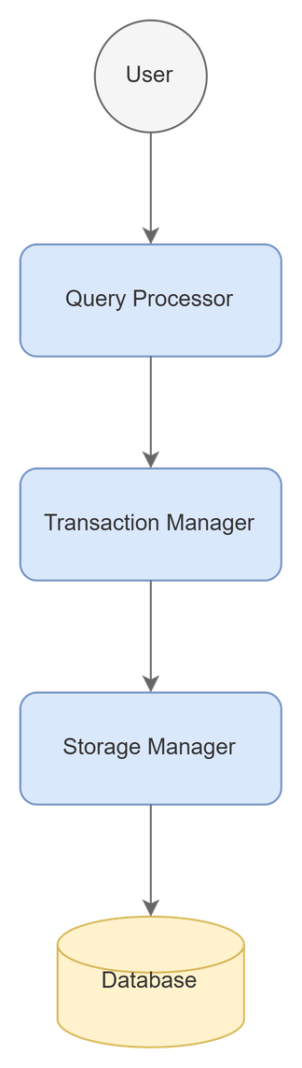
DBMS Architecture
Functions
Processes user requests.
Stores and retrieves data.
Maintains secure and reliable transactions.
7

Slide 17
Advantages and Conclusion
Advantages
Fast query processing.
Efficient data storage.
Secure transaction management.
Improves database performance.
Conclusion
The Query Processor, Storage Manager, and Transaction Manager work together to ensure efficient, secure, and reliable database operations in a DBMS.
6

Slide 18
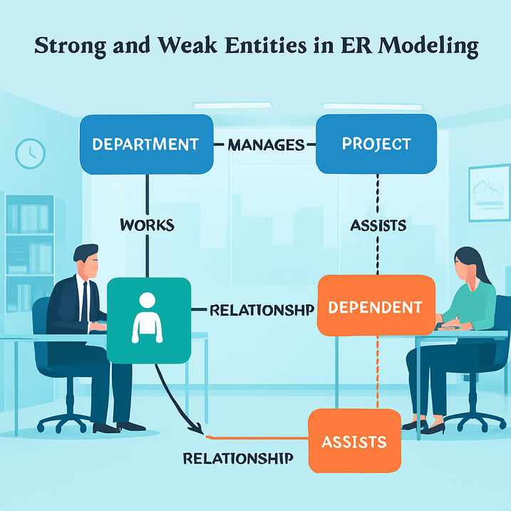
Strong and Weak Entities in ER Modeling
Strong and Weak Entities in ER Modeling
An entity represents a real-world object in a database.
Entities are classified as Strong Entities and Weak Entities.
They help define relationships and organize data efficiently in an ER model.
2

Slide 19
Strong Entity vs Weak Entity
Strong Entity
Has its own Primary Key.
Exists independently.
Represented by a single rectangle.
Example: Student, Employee, Customer
Weak Entity
Does not have a Primary Key.
Depends on a strong entity for identification.
Represented by a double rectangle.
Example: Dependent, Order Item, Nominee
3

Slide 20
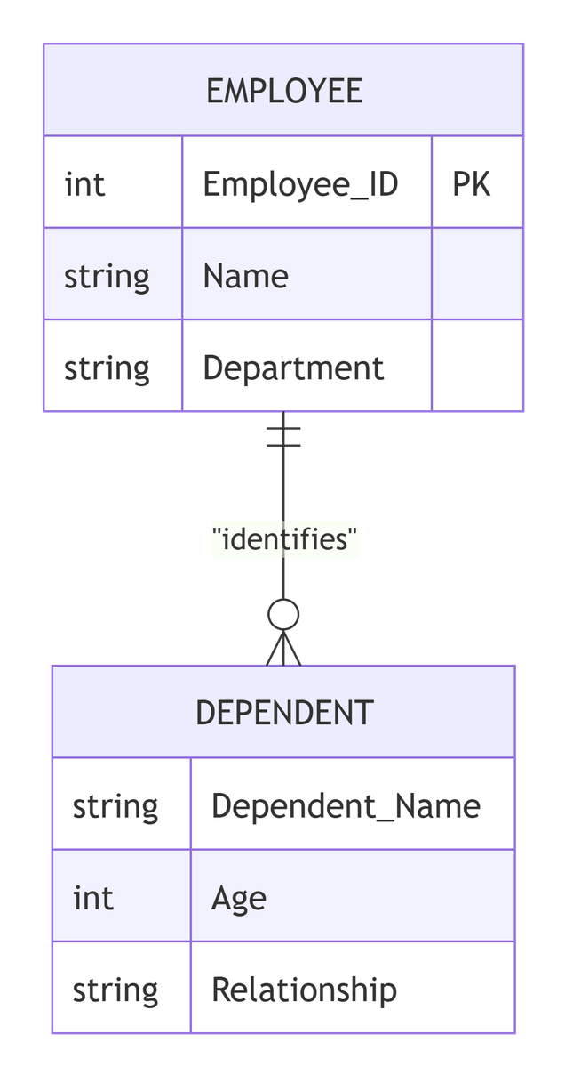
ER diagram showing Employee and Dependent
Strong Entity
Has Primary Key
Independent
Single Rectangle
Can exist alone
Weak Entity
No Primary Key
Depends on Strong Entity
Double Rectangle
Cannot exist alone
7

Slide 21
Applications and Conclusion
Applications
Banking Systems
Hospital Management
Library Management
Employee Database Systems
Conclusion
Strong entities have their own identity and can exist independently.
Weak entities rely on strong entities for identification.
Understanding these concepts helps in designing accurate and efficient ER models.
3

Slide 22
THANK YOU

